Slide 1


Singing Video
（aka Singing Photo3.0）
Video voice production services powered by AI

Slide 2
Singing Video (aka Singing photo3.0)
Video voice production services powered by AI
Make something
Using MSFT cloud and AI technologies, we created an app (Singing Video, aka Singing Photo 3.0)
to create background music, theme song, subtitles, narration, trailer with custom voice capability for any video content
Address the Challenge
Reduce cost and time to market for produce audio content (voice, music and sound effects) for video production
Customer Focus
Any professional or amateur video producer and vlogger
Business Value
Reduce cost and time to help people without audio professionals (sound, music, or voice over narration) to produce audio content for video production for vlogger, promo video, or other commercial advertising uses
Based on our experience on Singing Photo app, this project is feasible and actionable to implement within a reasonable time-frame (estimated 6 to 12 months for coding and testing). We also believe the chance of success is high based on our experience on a few versions of Singing Photo which has been launched in 2016 and 2017 for different marketing projects
Feasibility
Practice awareness: we put AI (NLP/deep learning) and cognitive services (vision, voice, emotion, translation, voice synthesis, etc.) into more real-life situations such as video production for non-professional vlogger, or commercial scenarios;
Exercise curiosity: we brainstorm about different real life and practical applications in using Singing Photo and also to explore whether this app can be further enhanced/upgraded to more interesting scenarios;
Demonstrate courage: we think out of the box, and out of our current job's roles and responsibilities to explore ideas and determine to make a successful product.
Inclusion

Slide 3
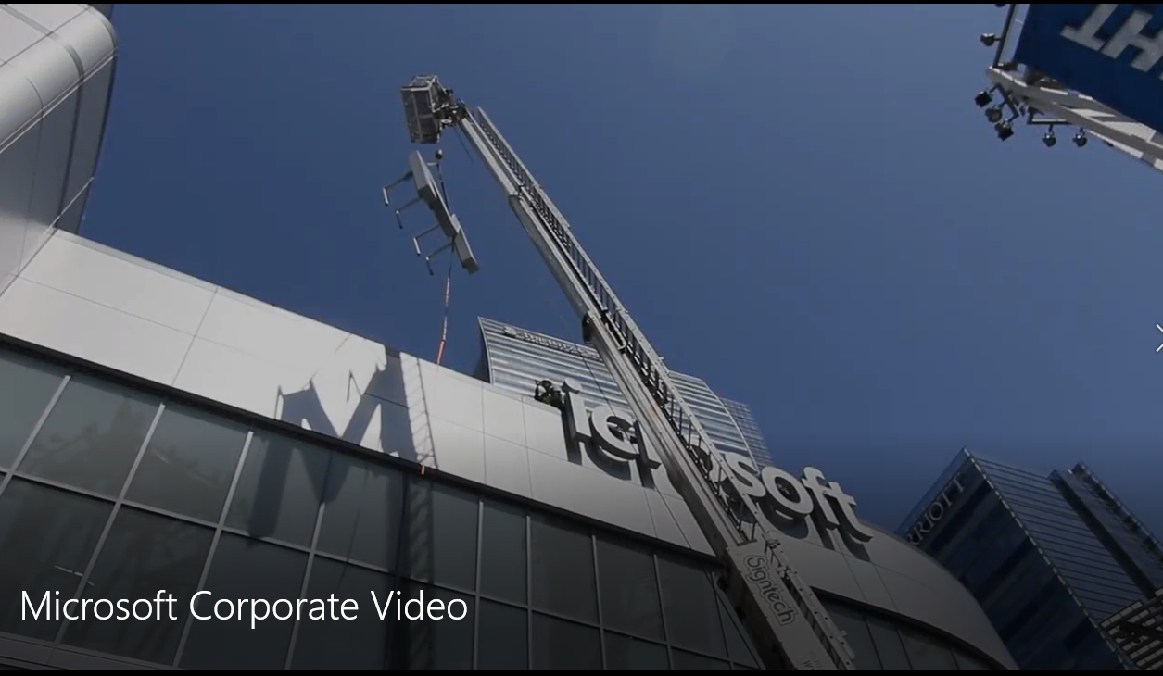

“I can help you do the following video editing: ”
√
Speech translate
AI narrator
Implant advertising
Background music
Theme Song
√
√
√
√

Slide 4
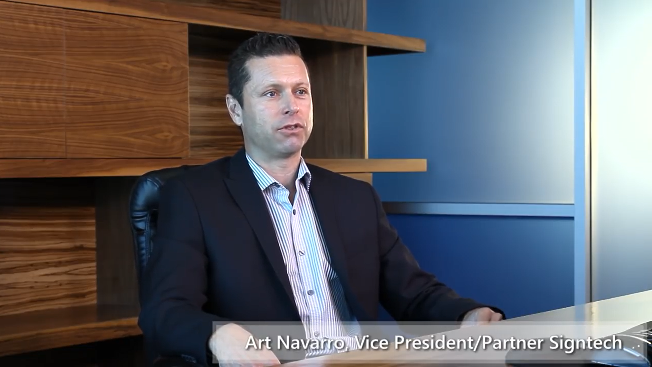
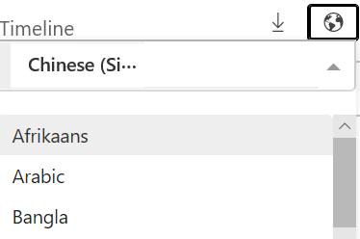
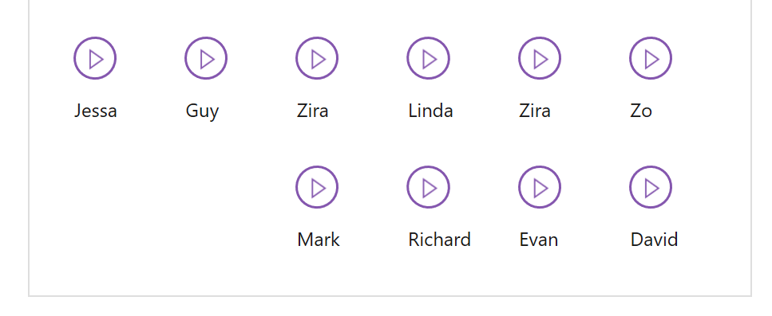
1：Speech translate
Choose language：
Choose voice：
这里假装有字幕
Here are fake subtitles
这里假装有字幕
Here are fake subtitles

Slide 5
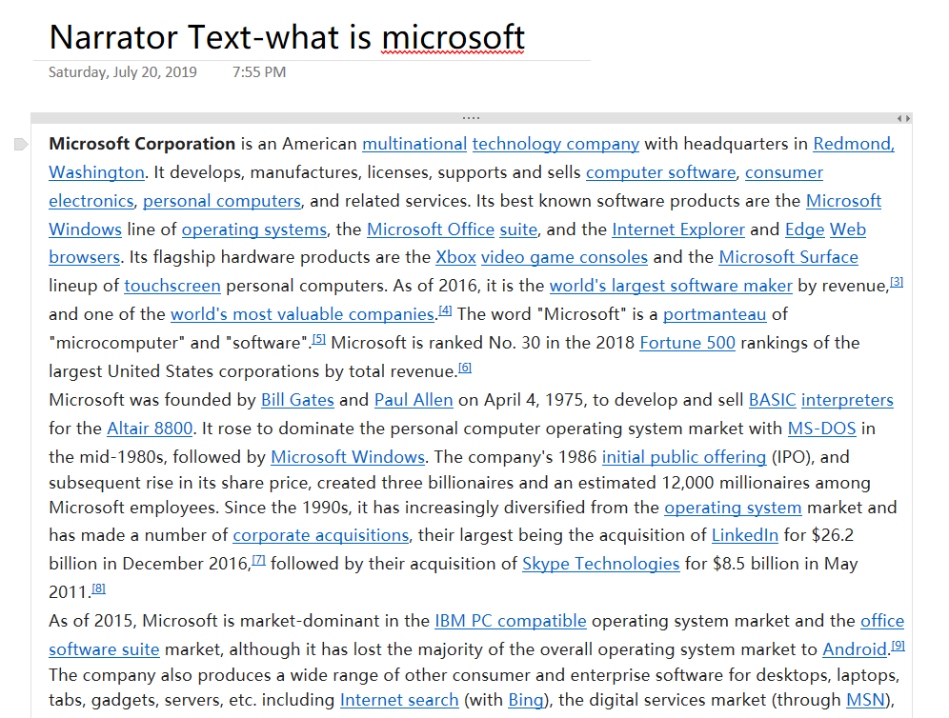
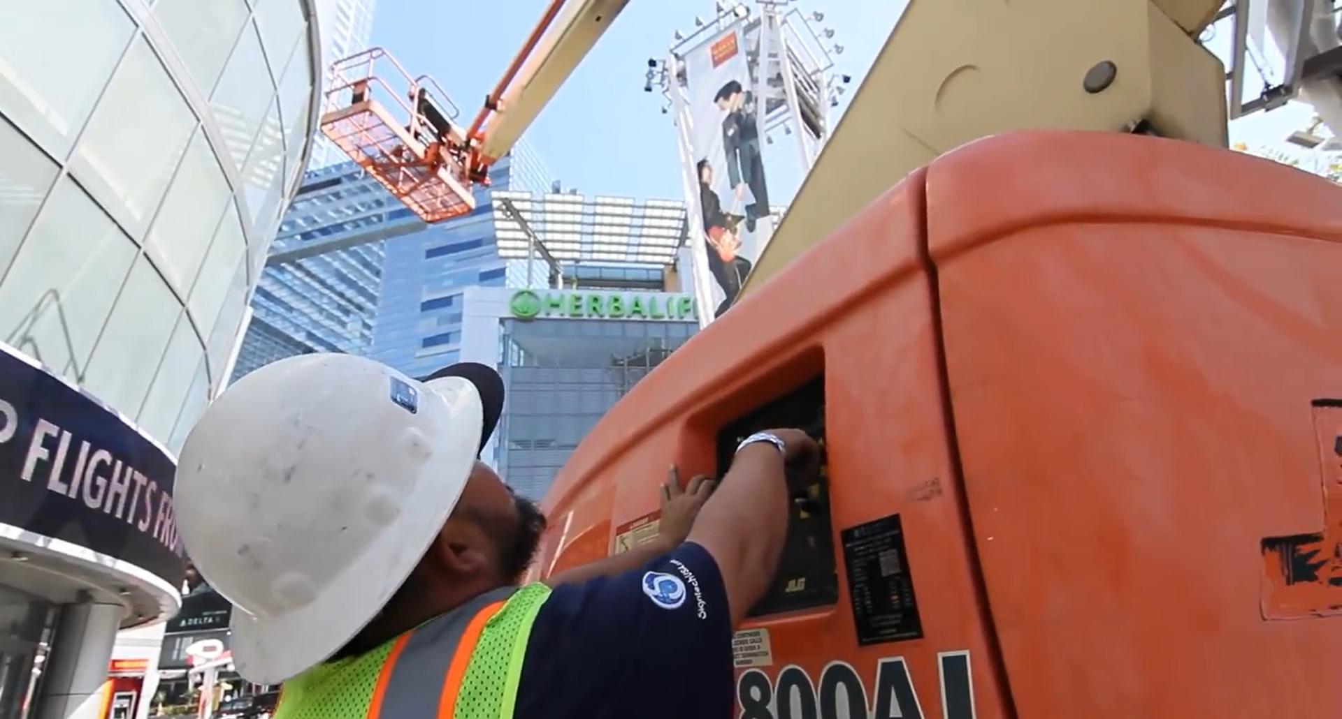
2：AI narrator
Choose voice：
这里是自动合成的旁白朗读
Here is an auto-synthesized voice-over
Notes:
AI 旁白：根据text内容自动调整节奏语速填充到video中。
2:31-2:35

Slide 6
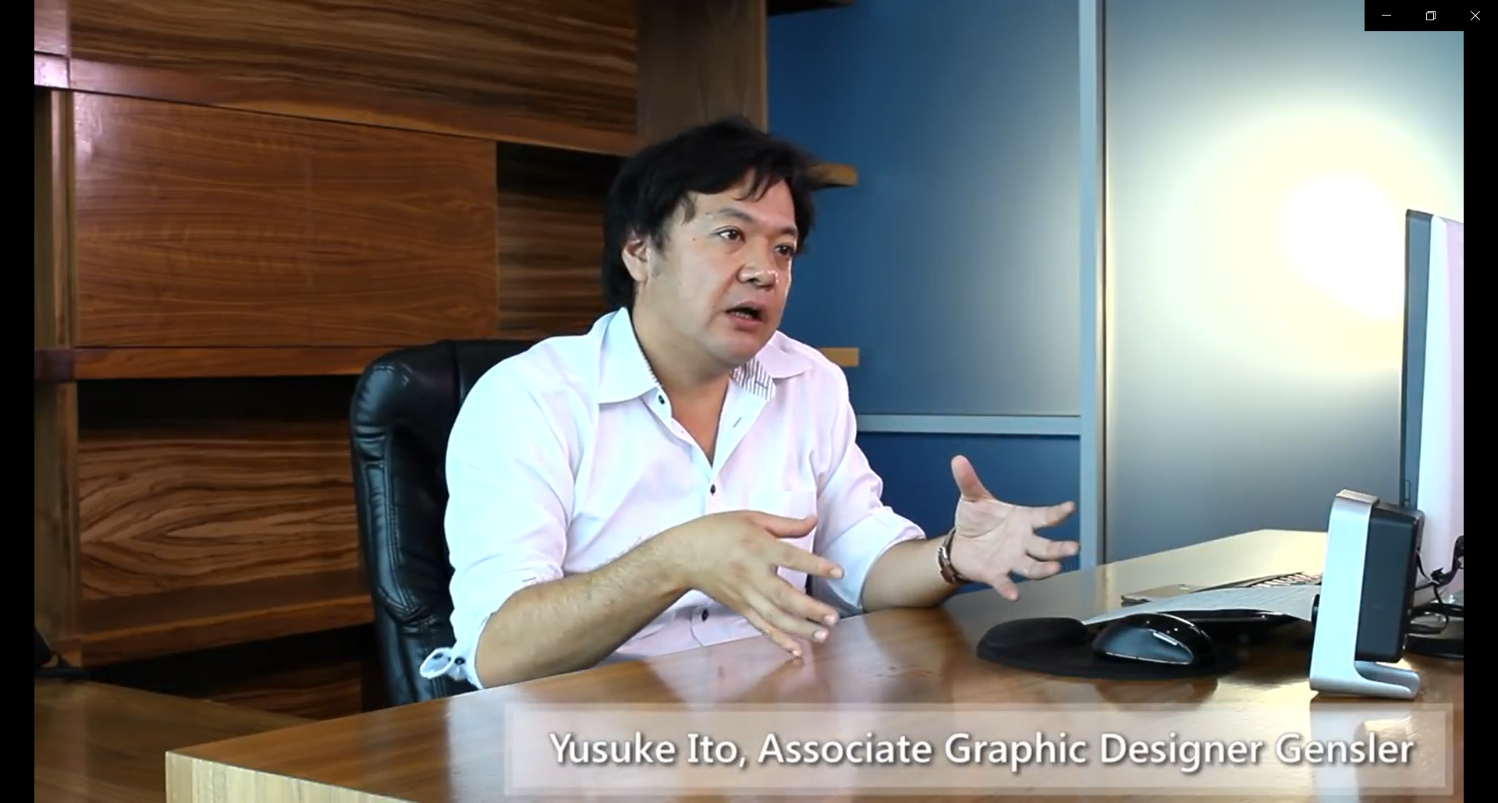


3. Implant ads
Notes:
2:39-2:44

Slide 7
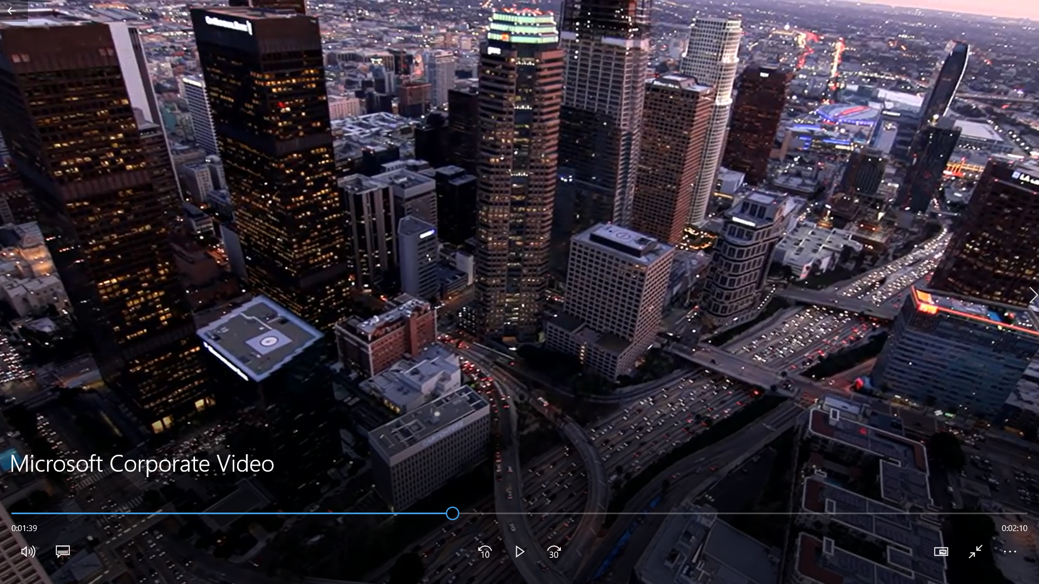


4.Background music
Notes:
2:54-2:59

Slide 8
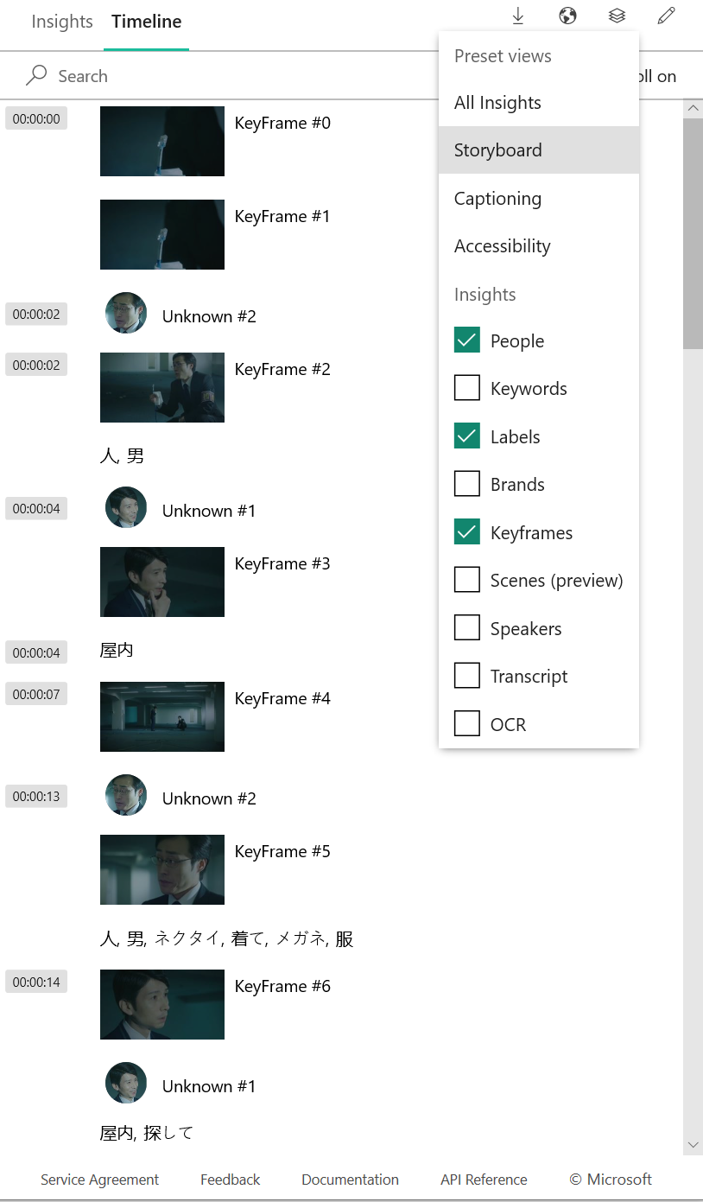
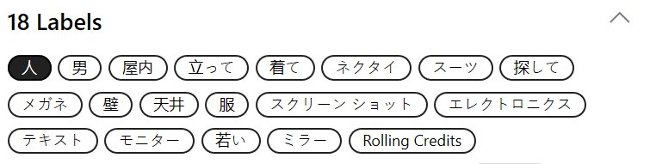
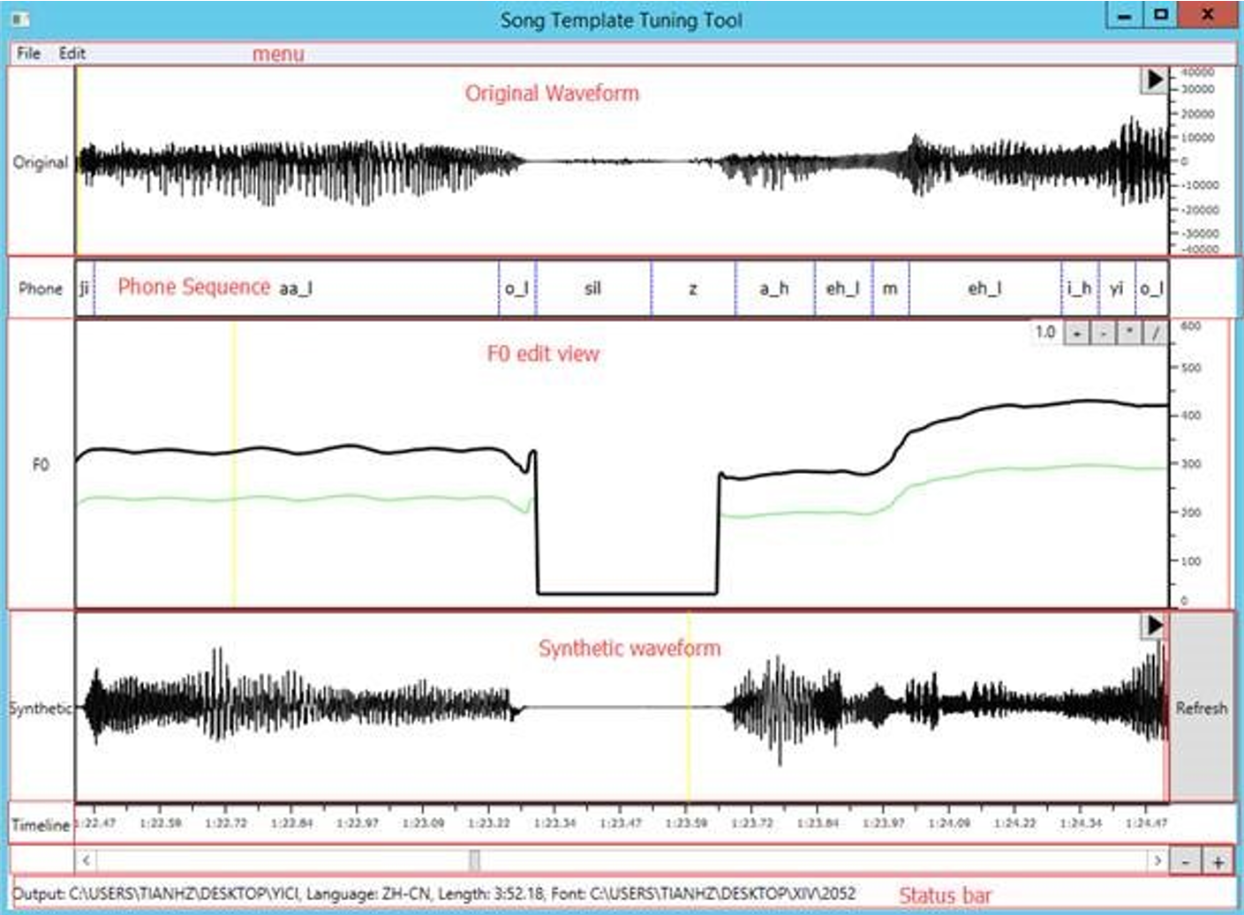
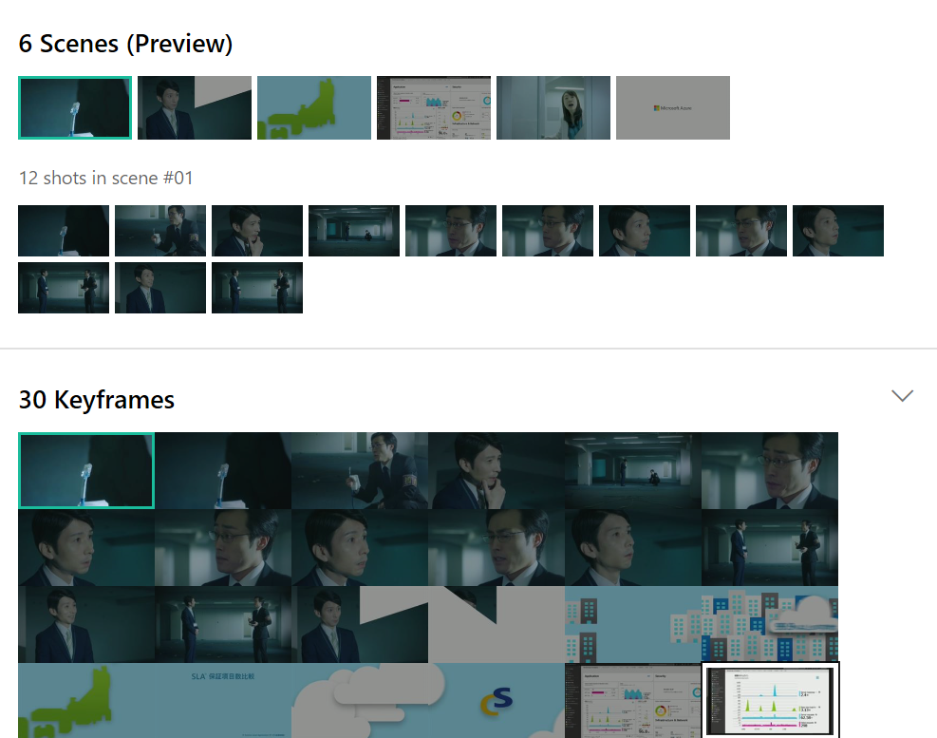


5.Theme Song
Music
Lyrics
Voice
Storyboard + emotion + keyword + transition ….. = Theme Song =

Slide 9
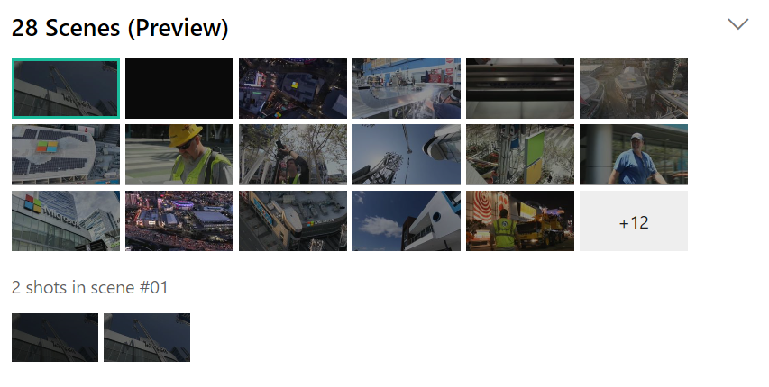
6.Movie Trailer
Notes:
根据关键帧做成预告片。怎么表现？0:08-0;20?

Slide 10
What technology I use

Slide 11
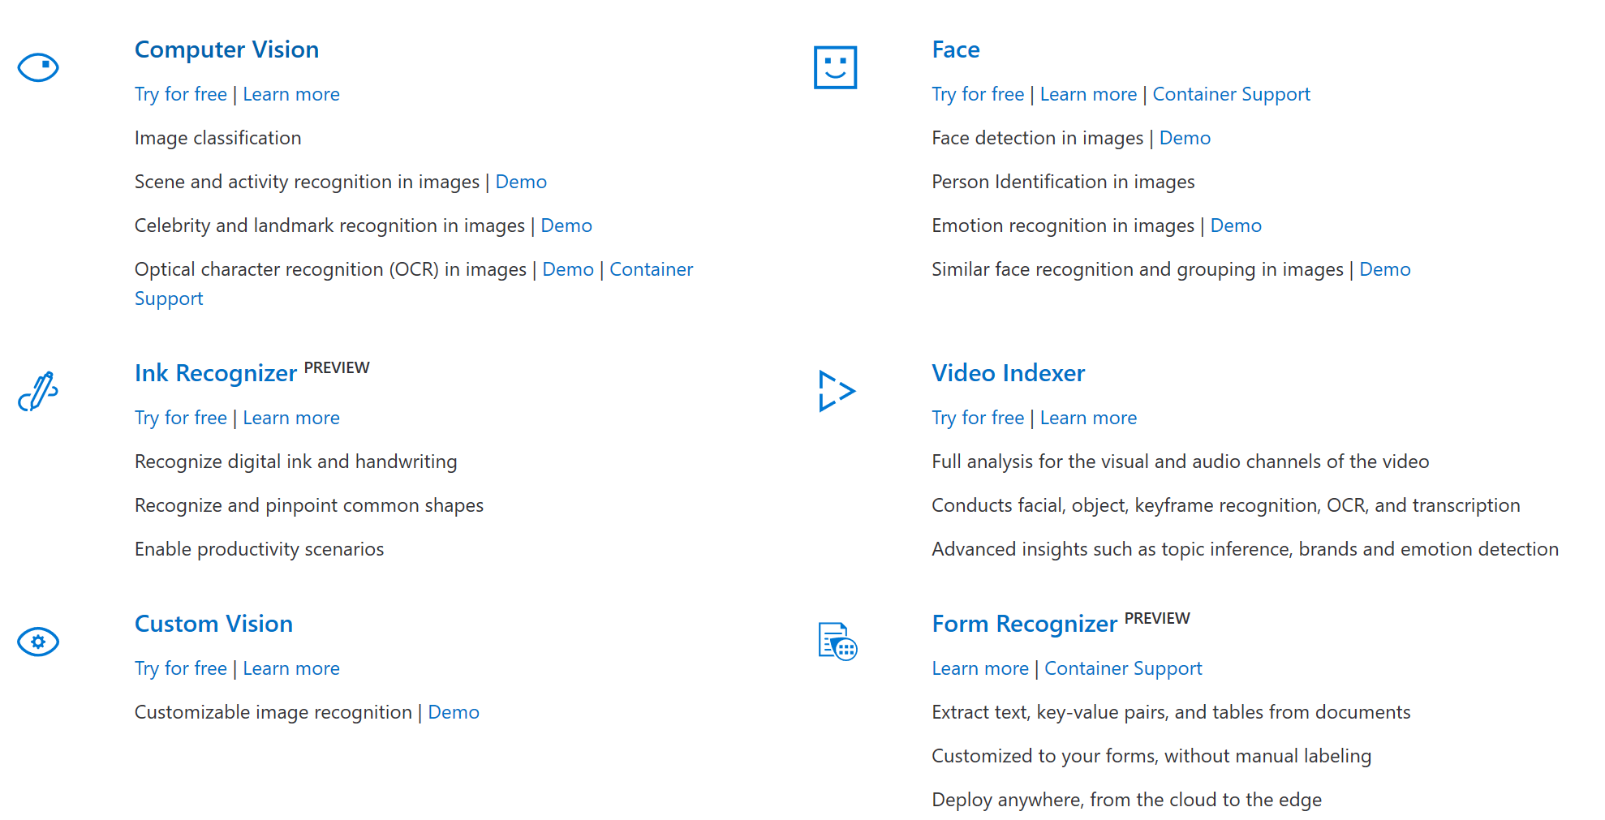
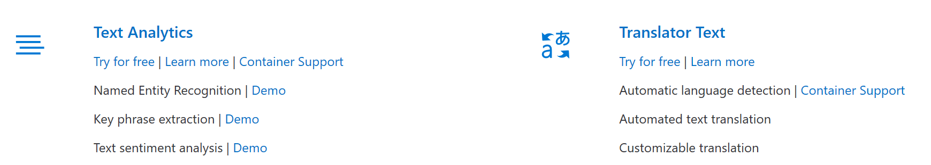
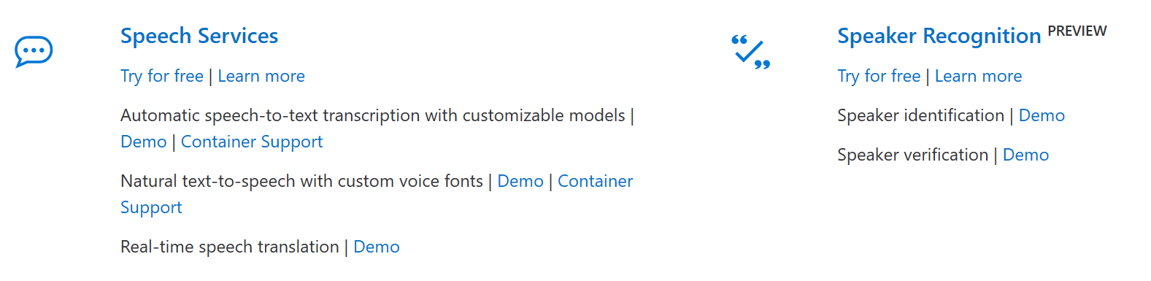
Technology
Based on our experience on Singing Photo app, this project is feasible and actionable to implement within a reasonable time-frame (estimated 6 to 12 months for coding and testing).

Slide 12
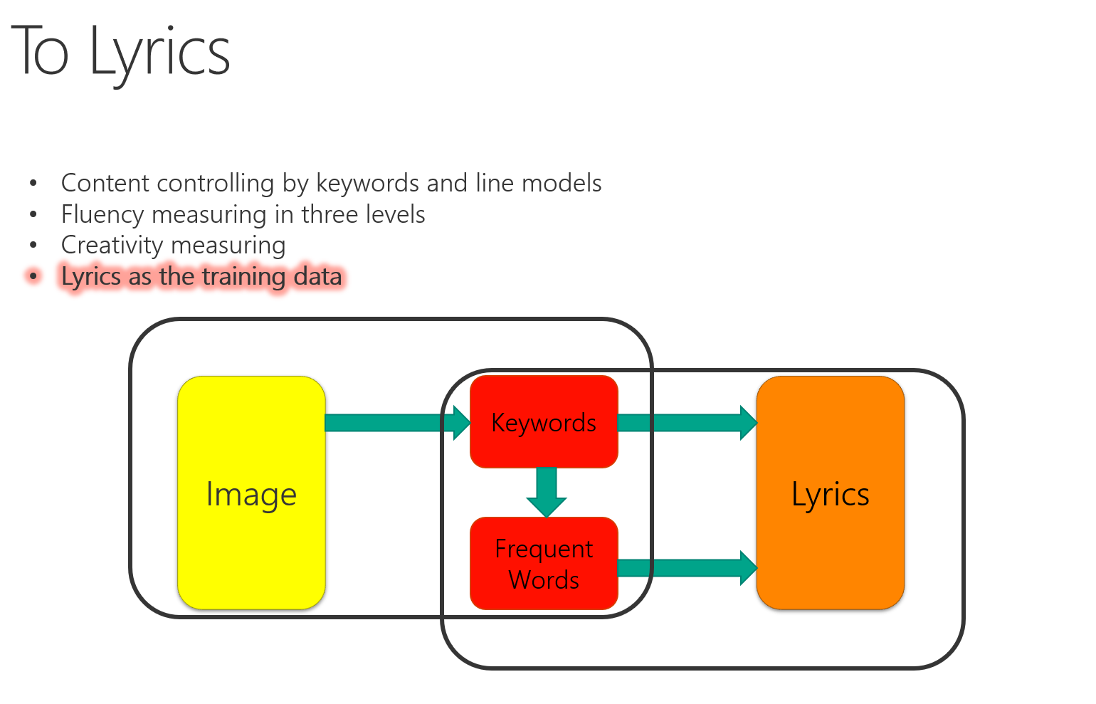
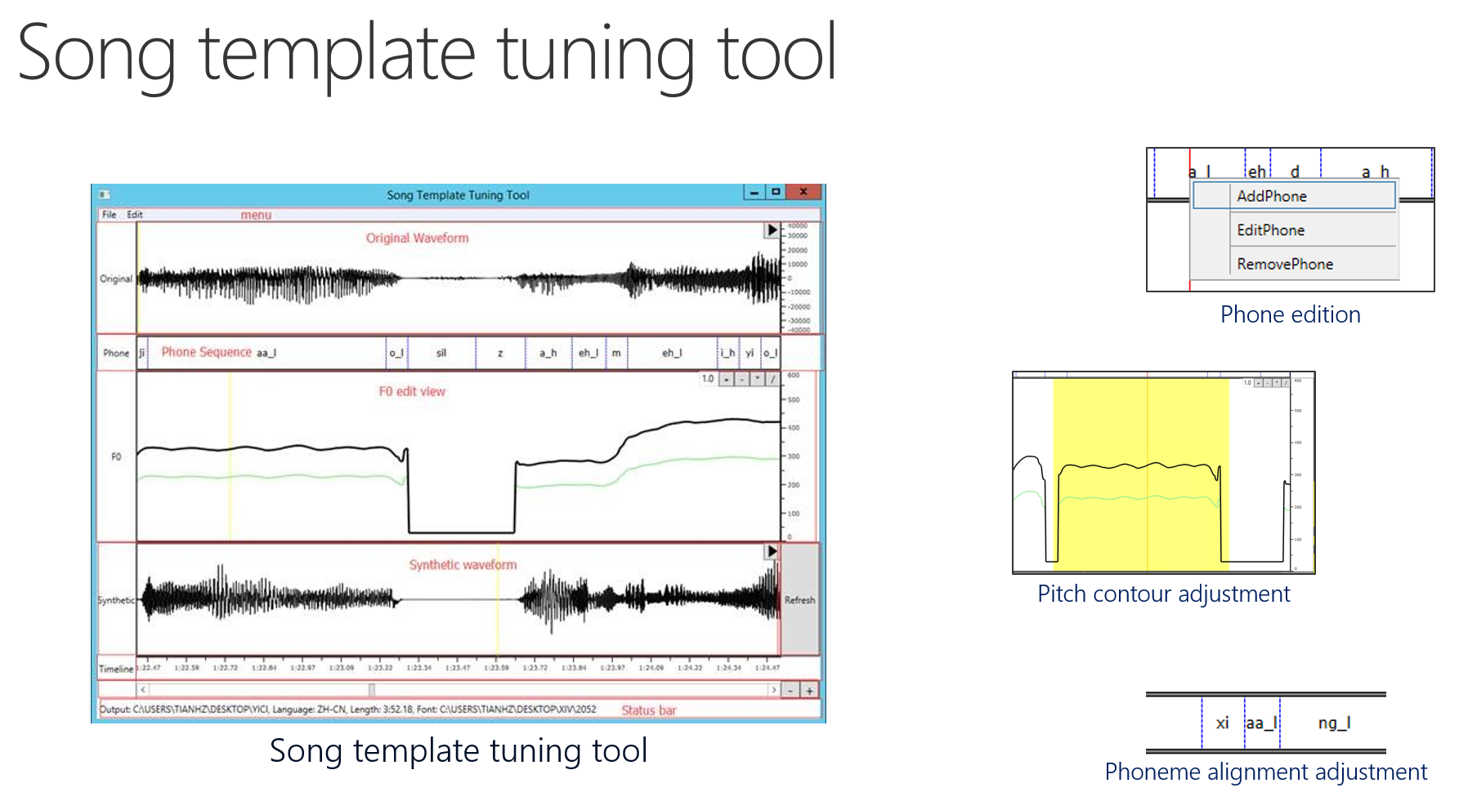
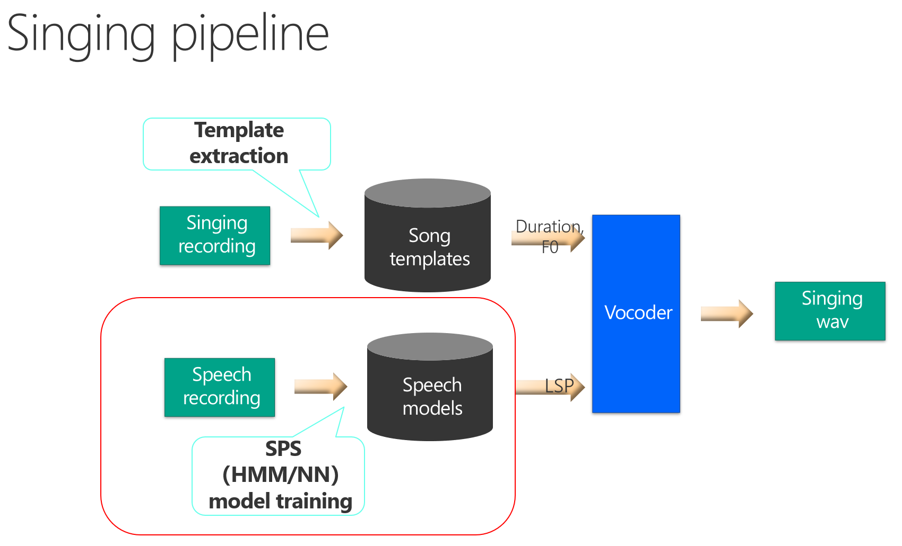
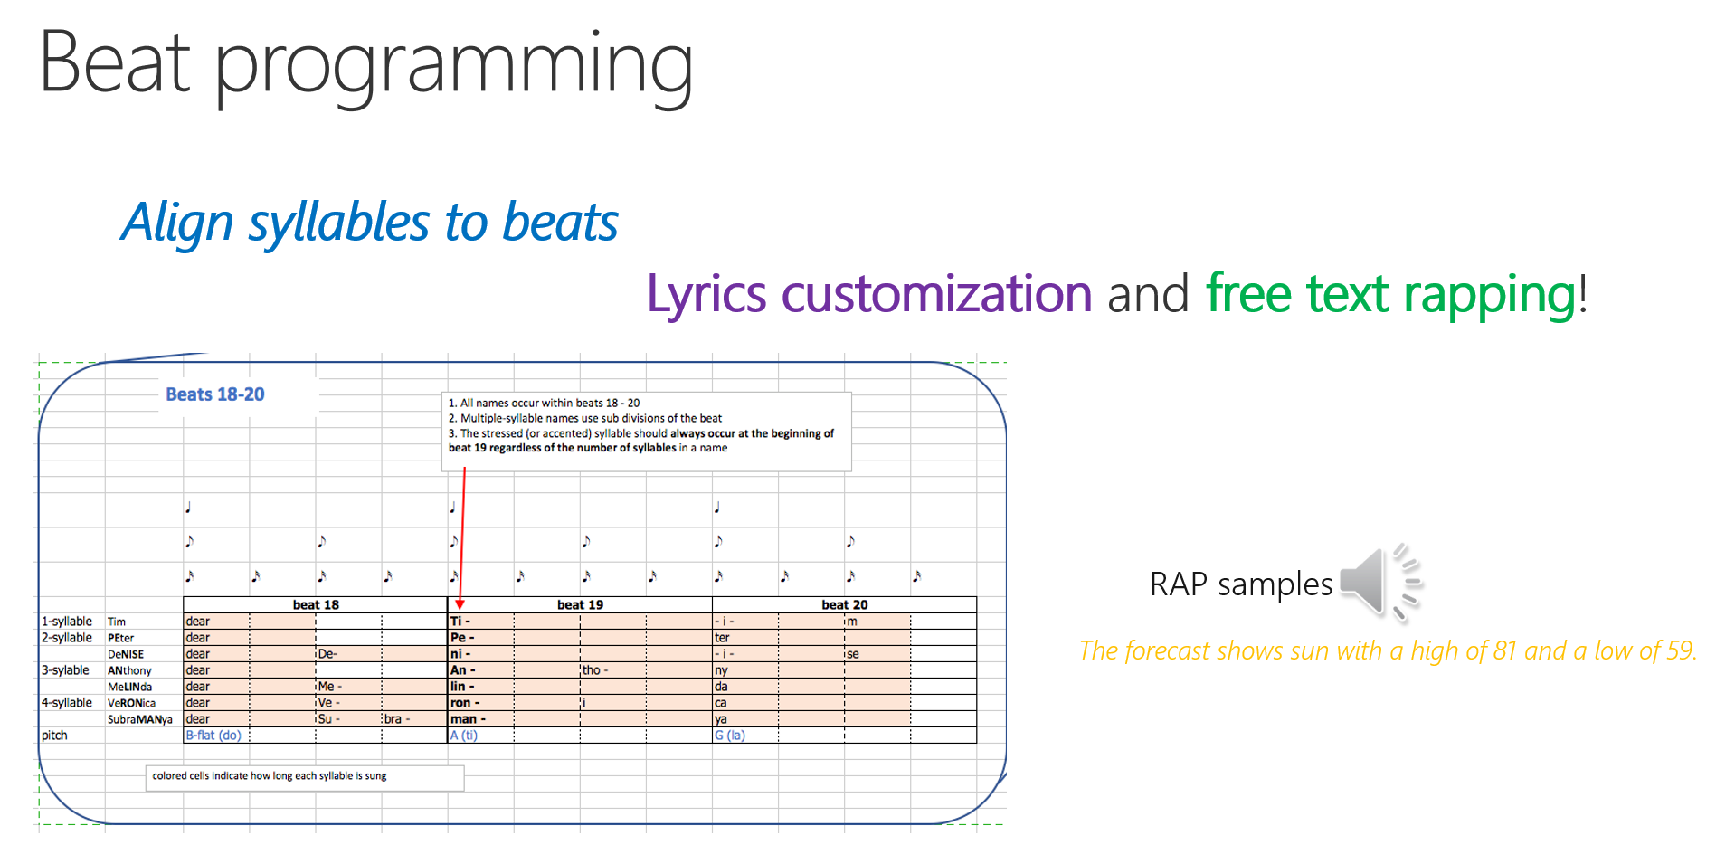
Part3: Technology
Key technology
We also believe the chance of success is high based on our experience on a few versions of Singing Photo which has been launched in 2016 and 2017 for different marketing projects

Slide 13
What Can I Bring
Cost saving
Time saving
Copyright free
Business opportunities of advertising and voice store

Slide 14

Singing Video
Video voice production services powered by AI
Members: Alan Ip /Yingtong Li/Qinying Liao/Yifei Xu
Xiaobin Liu/Yueying Liu/Siying Guo/Danfeng Li/
Xue Chen/Chao Chen
Notes:
又特写到电脑上
Members: Alan Ip /Yingtong Li/Qinying Liao/Yifei Xu
Xiaobin Liu/Yueying Liu/Siying Guo/Danfeng Li/
Xue Chen/Chao Chen

